Slide 1

Fraud Detection
Nicholas Catani
ISM-6359 Data Mining

Slide 2

Content Layout
Dataset & Application Software
Business reason
ML models & Results
Final thoughts

Slide 3

Dataset & Application Software
A list of transactions from various customers made in different time and amount at BankSim (an agent-based simulator of payments based on a sample of aggregate transactional data provided by a bank in Europe).
Synthetic data from a financial payment system | Kaggle
KNIME Analytics Platform

Slide 4
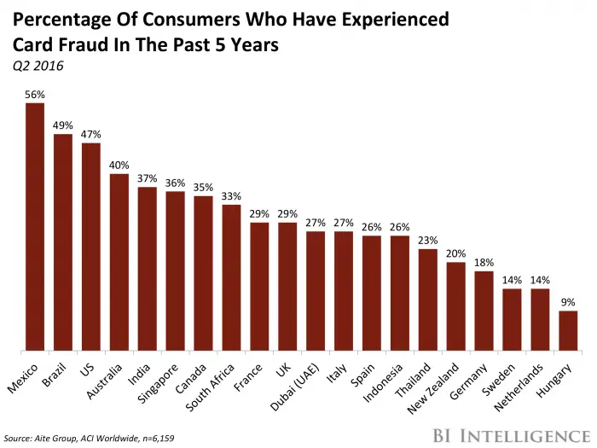
Business reason
Back in 2020, I’ve experienced a sim swap fraud that cost me $50000
Fraudulent behaviors affect peoples’ lives everyday!

Slide 5
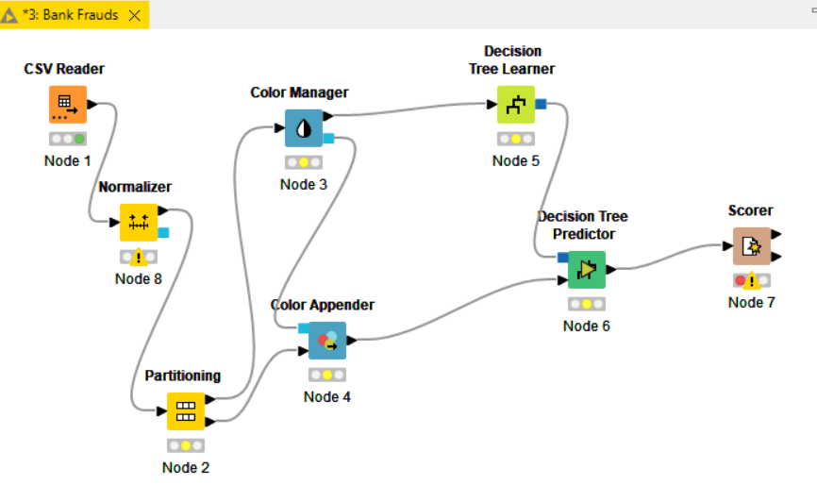
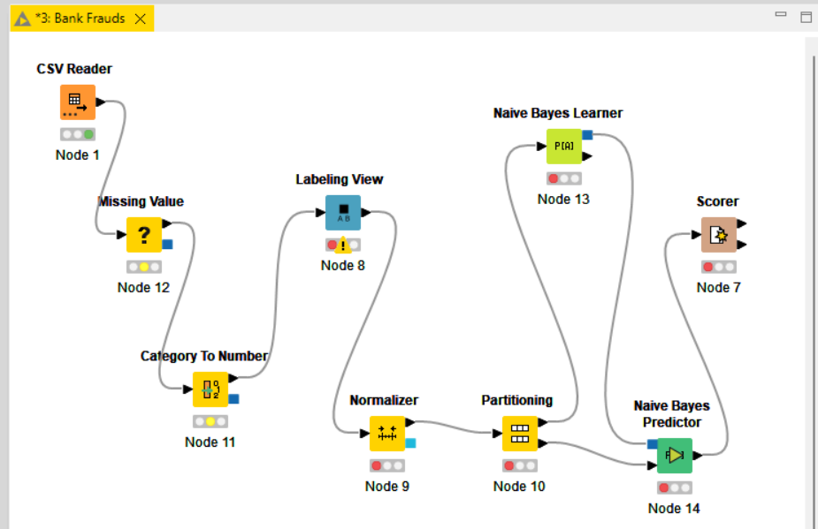
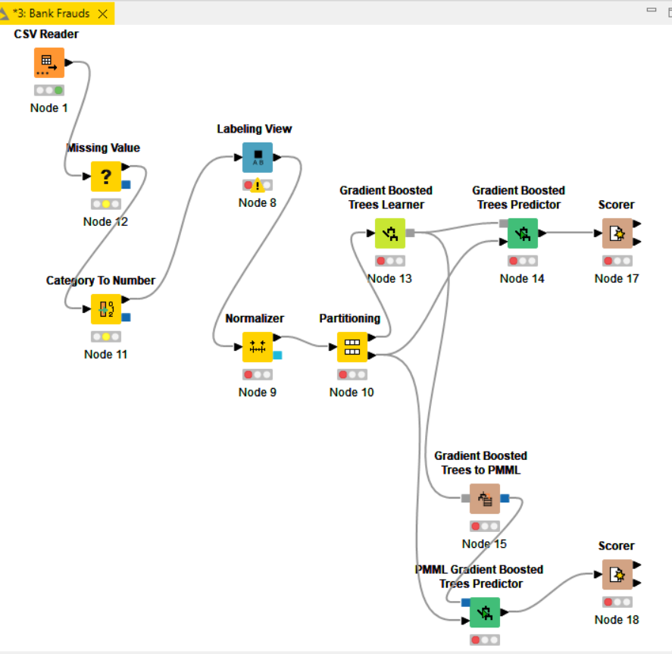
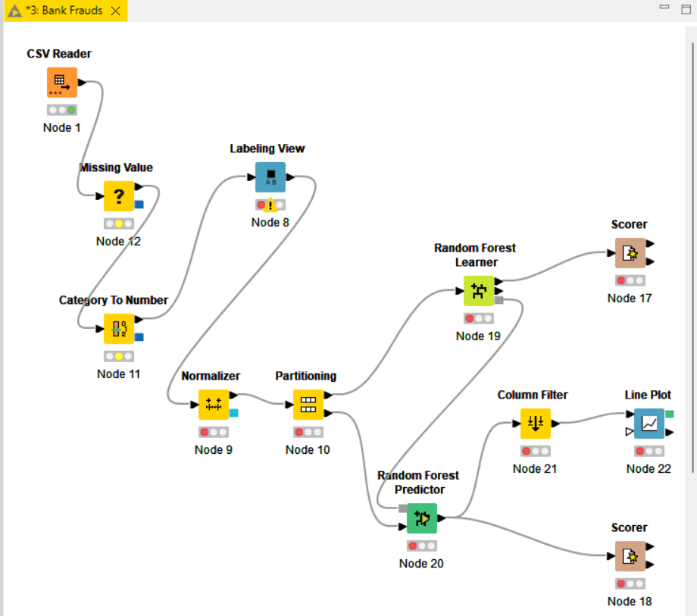
ML models & Results

Slide 6
Final Thoughts
The Dataset did not require considerable effort in data prep.
X Most of my models choked due to weak CPU.
X Dataset not large enough to run the experiment.
Buy a more powerful computer.
Invest more time into an application software to master it.

